Slide 1
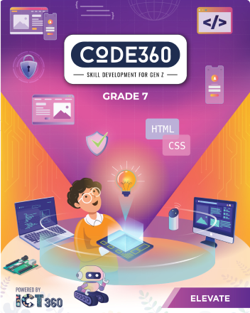
Mazen
Saad
Computer Teacher

Slide 2
ICT
Grade 7

Slide 3

Enter the notebook and write the following:

Slide 4

Lesson title
3D Environment
The Date
2025 / 9 /

Slide 5


Do you know what 3d environment is?

Slide 6

3D Environment :
A 3D environment is a computer-generated, three-dimensional digital space with depth and volume, allowing users to interact with virtual objects and simulated real-world scenarios.

Slide 7
What We'll Learn Today
1
3D
2
Environment
3
Modeling
4
Rendering

Slide 8

Start

Slide 11


Slide 12


Slide 13


Slide 14


Slide 15

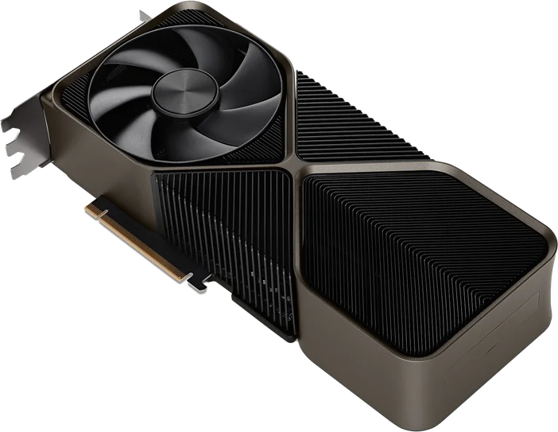

Slide 16

Exercise

Slide 17
Page Number 04

Slide 18
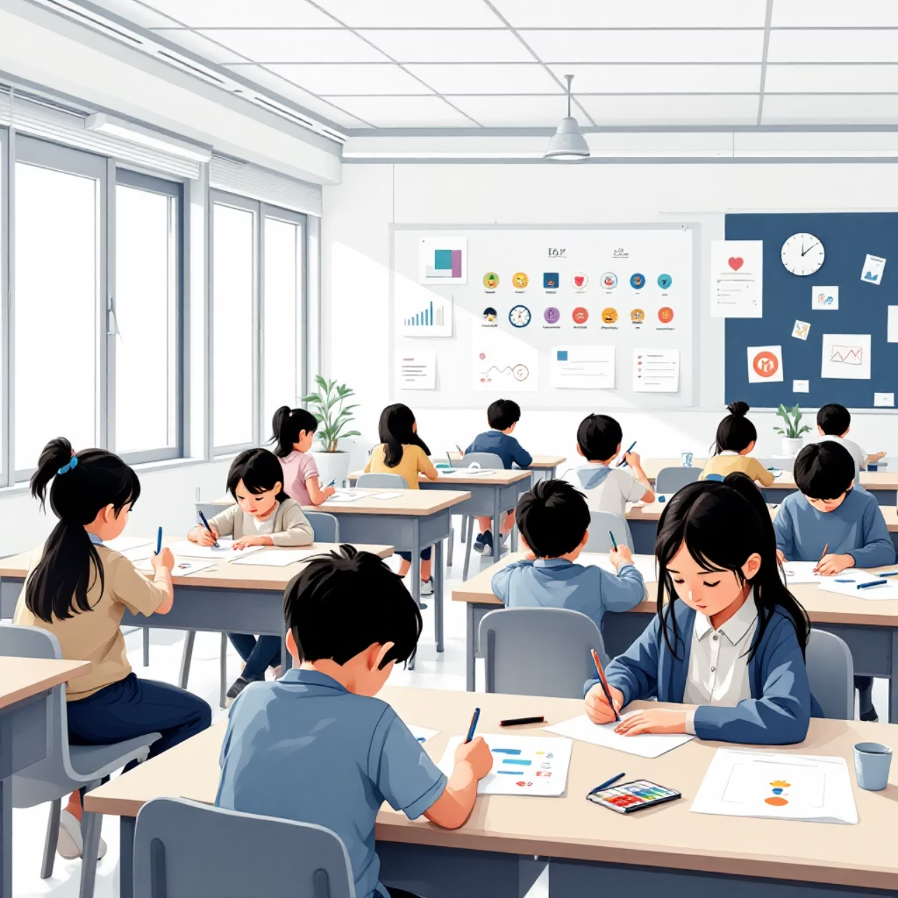

Slide 19

Do you have any other questions?

